Slide 1
Continuous-Time Fourier Transform
EE 313 Linear Systems and Signals Fall 2021
Prof. Brian L. Evans
Dept. of Electrical and Computer Engineering
The University of Texas at Austin
Textbook: McClellan, Schafer & Yoder, Signal Processing First, 2003
Lecture 15 http://www.ece.utexas.edu/~bevans/courses/signals

Slide 2
Linear Systems and Signals Topics
Continuous-Time Fourier Transform – SPFirst Ch. 11 Intro
Domain | Topic | Discrete Time | Continuous Time
Time | Signals | SPFirst Ch. 4 | SPFirst Ch. 2
 | Systems | SPFirst Ch. 5 | SPFirst Ch. 9
 | Convolution | SPFirst Ch. 5 | SPFirst Ch. 9
Frequency | Fourier series | ** | SPFirst Ch. 3
 | Fourier transforms | SPFirst Ch. 6 | SPFirst Ch. 11
 | Frequency response | SPFirst Ch. 6 | SPFirst Ch. 10
Generalized Frequency | z / Laplace Transforms | SPFirst Ch. 7-8 | Supplemental Text
 | Transfer Functions | SPFirst Ch. 7-8 | Supplemental Text
 | System Stability | SPFirst Ch. 8 | SPFirst Ch. 9
Mixed Signal | Sampling | SPFirst Ch. 4 | SPFirst Ch. 12
✔
✔
✔
✔
✔
✔
✔
✔
✔
➔
✔
✔
✔
✔
✔
✔
✔
** Spectrograms (Ch. 3) for time-frequency spectrums (plots) computed the discrete-time Fourier series for each window of samples.

Slide 3
Continuous-Time Fourier Transform
Continuous-Time Fourier Transform – SPFirst Ch. 11 Intro
General definition of the frequency spectrum
Define a precise notion of bandwidth
Explain inner workings of communication systems
Analyze continuous-time linear time-invariant filters
Periodic signals (SPFirst Ch. 3)
Continuous-time periodic signals represented as sum of cosines
Cosine frequencies integer multiples of fundamental frequency
Fundamental frequency ω₀ = 2 π / T₀; T₀ is fundamental period
Linear time-invariant systems (SPFirst Ch. 10)
Output frequencies are only those present in input

Slide 4
Continuous-Time Fourier Transform
Continuous-Time Fourier Transform – SPFirst Sec. 11-1
Forward direction
Analysis: extracts spectrum information from the signal x(t)
Inverse direction
Synthesis: creates time-domain signal x(t) from its spectral info
Build up transform pairs and properties (pp. 338-339)
As we did for z-transforms and we’ll do for Laplace transforms
Example continuous-time Fourier transforms
Dirac delta:
Delayed Dirac delta:
δ(t)
h(t)
Impulse response of an ideal delay by T seconds

Slide 5
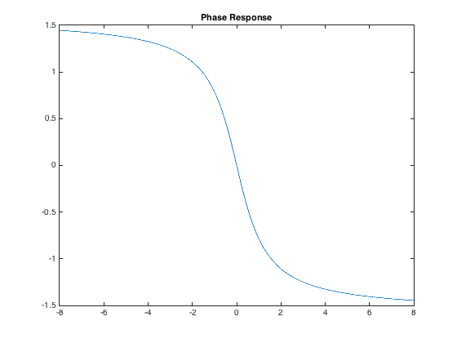
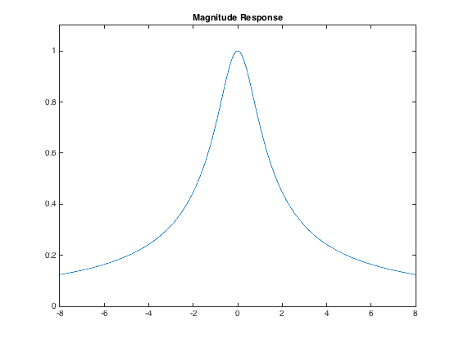
Causal Exponential Signal
Continuous-Time Fourier Transform – SPFirst Sec. 11-4.1
Formula:
w = -8 : 0.01 : 8;
H = 1 ./ (1 + j*w);
Hmag = abs(H);
Hphase = phase(H);
figure;
plot(w, Hmag);
title('Magnitude Response');
ylim( [-0.0 1.1] );
figure;
plot(w, Hphase);
title('Phase Response');
Decays if Re{a} > 0
Oscillates
Magnitude-Phase form
a = 1
See lecture slide 14-5 for an example when a = 2

Slide 6
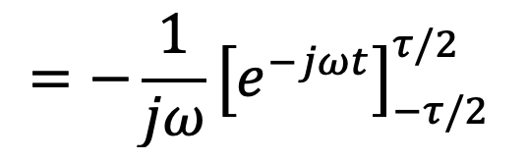
Rectangular Pulse in Time
Continuous-Time Fourier Transform – SPFirst Sec. 11-4.2
x(t)
X(jω)
τ
1
F
ω
t
-τ/2
0
τ/2
−6π
−4π
−2π
0
2π
4π
6π
τ
τ
τ
τ
τ
τ
Visualizing Fourier transforms adds insight and guides mathematics

Slide 7
Impulse in Time or Frequency
Continuous-Time Fourier Transform – SPFirst Sec. 11-4.4
From sifting property of Dirac delta,
Consider Dirac delta in Fourier domain
Using linearity property, F{ 1 } = 2π δ(ω)
x(t) = 1
X(jω) = 2π δ(ω)
1
F
(2π)
t
ω
0
0
(2π) indicates area under Dirac delta

Slide 8
Two-Sided Cosine Signal
Continuous-Time Fourier Transform – SPFirst Sec. 11-4.5
x(t) = cos(ω₀ t)
X(jω)
(π)
(π)
F
t
ω
0
−ω₀
0
ω₀

Slide 9
Duality
Continuous-Time Fourier Transform – SPFirst Sec. 11-8
Forward/inverse transforms are similar
Example: rect(t / τ) ↔ τ sinc(ω τ / (2π))
Apply duality τ sinc(t τ/(2π)) ↔ 2 π rect(-ω/τ)
rect(·) is even τ sinc(t τ/(2π)) ↔ 2 π rect(ω/τ)
X(jt)
τ
F
2π
t
ω
−6π
−4π
−2π
0
2π
4π
6π
-τ/2
0
τ/2
τ
τ
τ
τ
τ
τ

Slide 10
Scaling
Continuous-Time Fourier Transform – SPFirst Sec. 11-5.1
For a ≠ 0 and given x(t) ↔ X(jω)
|a| > 1: compress time axis, expand frequency axis
|a| < 1: expand time axis, compress frequency axis
Extent in time domain is inversely proportional to extent in frequency domain (a.k.a. bandwidth)
x(t) is wider ↔ spectrum is narrower
x(t) is narrower ↔ spectrum is wider

Slide 11
Shifting in Time
Continuous-Time Fourier Transform – SPFirst Sec. 11-7.1
Shifting in time
Does not change magnitude of Fourier transform
Shifts phase of Fourier transform by –ω t₀ (so –t₀ is slope of the linear phase)
Derivation
Let u = t – t₀, so du = dt and integration limits stay same

Slide 12
Sinusoidal Amplitude Modulation
Continuous-Time Fourier Transform – SPFirst Sec. 11-8
Multiplication in time is convolution in frequency
F
F
Alternate derivation (SPFirst Sec. 12-2.1)

Slide 13
Amplitude Modulation by Cosine
Continuous-Time Fourier Transform – SPFirst Sec. 11-8
y(t) = x(t) cos(ω_{c} t)
Assume x(t) is ideal lowpass signal with bandwidth ω₁ < ω_{c}
1
X(jω)
Y(jω)
½X(j(ω + ω_{c}))
½X(j(ω − ω_{c}))
½
ω
-ω₁
0
ω₁
ω
-ω_{c} - ω₁
-ω_{c} + ω₁
ω_{c} - ω₁
ω_{c} + ω₁
0
−ω_{c}
ω_{c}
What are applications of amplitude modulation?

Slide 14
Amplitude Demodulation by Cosine
Continuous-Time Fourier Transform – SPFirst Sec. 11-8
How to recover x(t) from y(t) = x(t) cos(ω_{c} t) ?
Y(jω)
½ X(j(ω + ω_{c}))
½ X(j(ω − ω_{c}))
½
ω
-ω_{c} - ω₁
-ω_{c} + ω₁
0
ω_{c} - ω₁
ω_{c} + ω₁
−ω_{c}
ω_{c}
F{ y(t) cos(ω_{c} t) } = ½ Y(j(ω + ω_{c})) + ½ Y(j(ω – ω_{c}))
attenuate
½ X(jω)
attenuate
¼ X(j(ω + 2ω_{c}))
½
¼ X(j(ω − 2ω_{c}))
ω
−2ω_{c}−ω₁
− 2ω_{c}+ω₁
-ω₁
0
ω₁
2ω_{c}− ω₁
2ω_{c}+ω₁
−2ω_{c}
−ω_{c}
keep
ω_{c}
2ω_{c}

Slide 15
Time Differentiation Property
Continuous-Time Fourier Transform – SPFirst Sec. 11-7.2
Conditions
f(t) → 0 when |t| → ∞
f(t) is differentiable
Derivation of property: Given f(t) ⇔ F(jω)

Slide 16
Time Integration Property
Example
15-16

Slide 17
License Info for SPFirst Slides
McClellan, Schafer &Yoder have released their work under a Creative Commons License with the following terms:
Attribution
The licensor permits others to copy, distribute, display, and perform the work. In return, licensees must give the original authors credit.
Non-Commercial
The licensor permits others to copy, distribute, display, and perform the work. In return, licensees may not use the work for commercial purposes—unless they get the licensor's permission.
Share Alike
The licensor permits others to distribute derivative works only under a license identical to the one that governs the licensor's work.
Full Text of the License
This (hidden) page should be kept with the presentation
©2003-2016, JH McClellan & RW Schafer
15-17

